Slide 1


Hoodie
Music
Downloader
Mobile Application and Cloud Computing 2019/2020

Slide 2

-[
Describing our Team
]-
Our Team
Luca Tomei 1759275
Danilo Marzilli 1878501
Giovanni Trinca 1542534

Slide 3
Introduction
Structure
OUTLINE
OF
TALK
Design
Look and Feel
Conclusion
Future Works

Slide 4
Hoodie is the best way to easily download and listen to songs:
Stream
Download
Unlimited library
Portrait and horizontal mode
Trending music by genre Charts
MAIN
FEATURES
Introduction.

Slide 5
-[
AN AGILE PROCESS
]-
Our Approach
In order to develop the application correctly we decided to use a SCRUM approach, proceeding by sprints.
Introduction.

Slide 6



Used Technologies
Backend
Frontend
Node.js
Asynchronous event-driven Javascript runtime.
We use Node.js to download songs directly from Deezer.
Firebase
Backend as a Service
(Baas).
We store our users, their searches, all the stuff needed by our app.
Swift
Powerful and intuitive programming language for macOS, iOS, watchOS and tvOS that support both object-oriented and functional programming.
Structure.

Slide 7


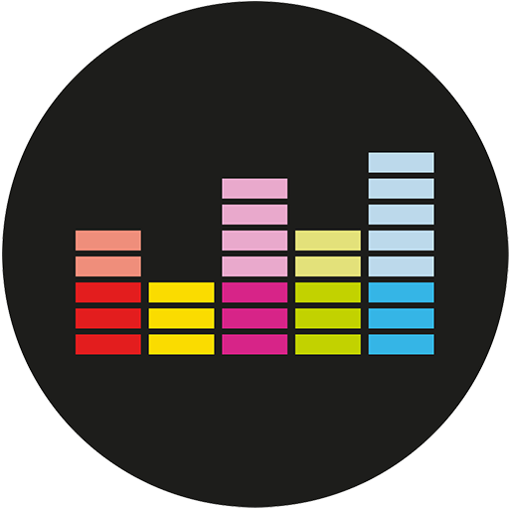
Application Architecture
Mobile Application
Raspberry Pi
Deezer Api
The mobile application developed in Swift allows communication with the server.
Here is where our backend lies, it handles users and their permissions, together with music download.
Deezer Simple API provides a nice set of services to build up applications allowing the discovery of music catalogue.
Structure.

Slide 8





Backend Structure
Firebase Login
Google Signin
Facebook API
Firebase Realtime Database
Raspberry Pi
We have managed the authentication features with Firebase Authentication, Google OAuth 2 and Facebook API.
Raspberry hosts our server. Through the "express" framework, with the listen method, the application listens on port 8080.
This is used to carry on some important data of the user to provide a better UX.
Structure.

Slide 9
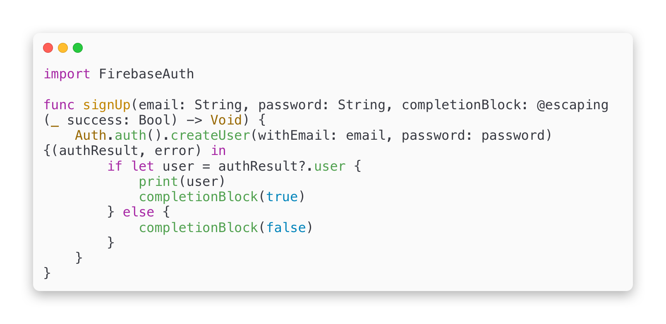
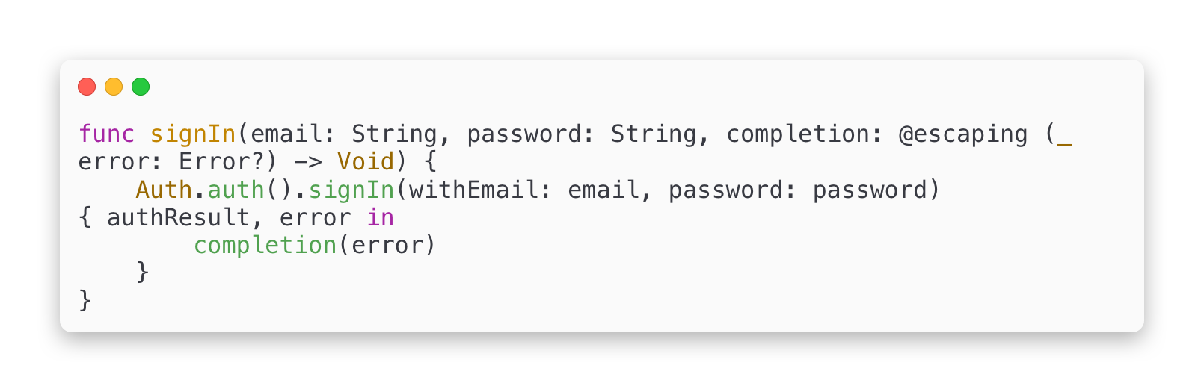
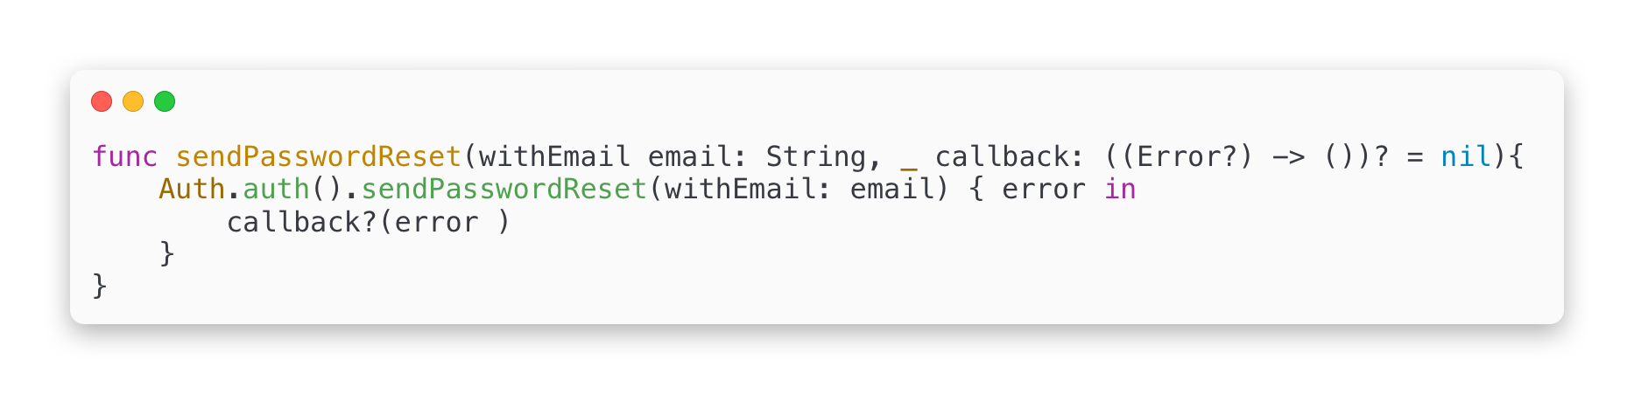
FIREBASE AUTHENTICATION
We use Firebase Authentication to allow users to log into our app using their personal email and password.
These credentials will be passed to the Firebase Authentication SDK and after getting a response from their servers, the user's data will be saved to Firebase Realtime Database.
Structure.

Slide 10
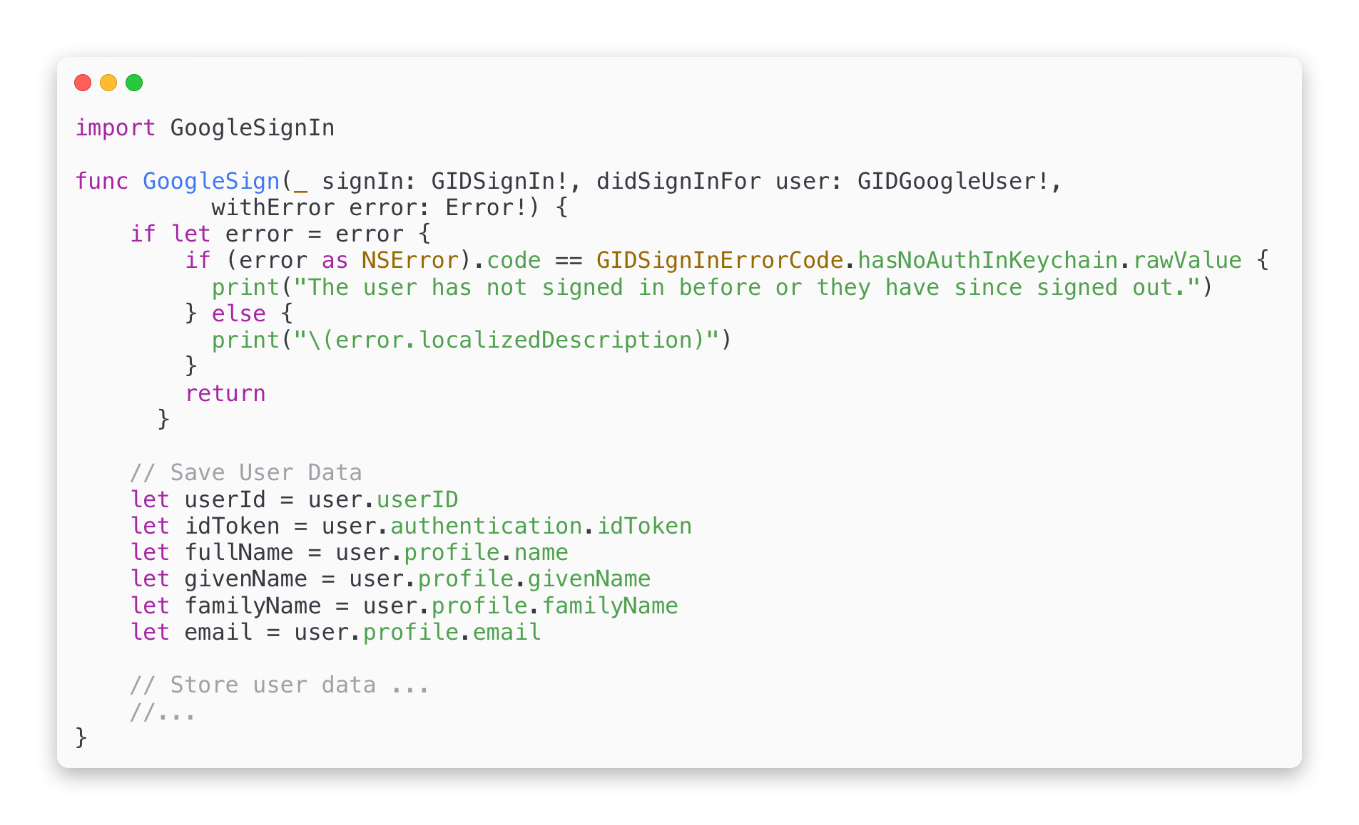
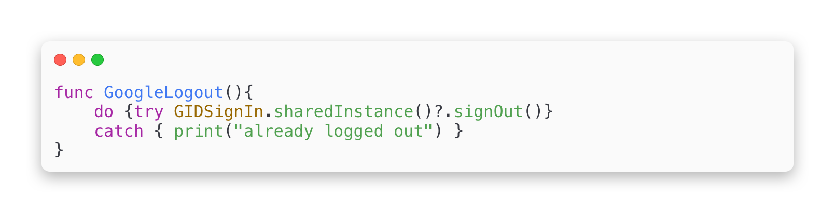
GOOGLE AUTHENTICATION
Google Sign-In manages the OAuth 2.0 flow and token lifecycle, simplifying our integration with Google APIs.
OAuth 2.0 works with the following four actors:
authorization server: responsible for authentication and authorization.
resource server: in charge of serving up resources if a valid token is provided.
resource owner: the owner of the data, that is, the end user of Hoodie.
client: the Hoodie mobile app
Structure.

Slide 11
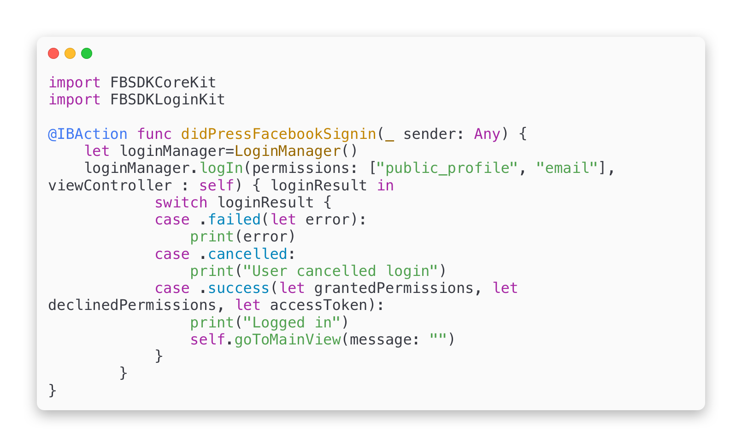
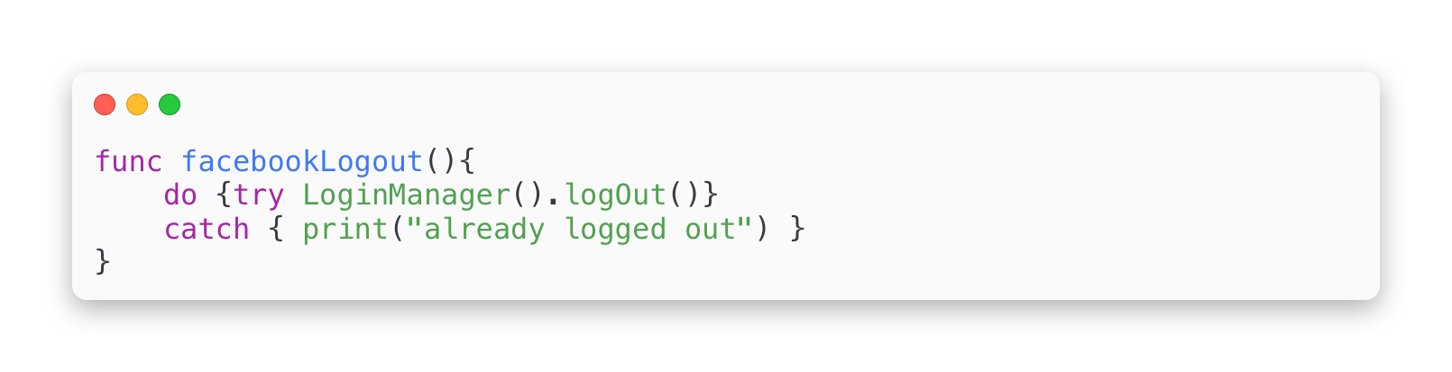
FACEBOOK AUTHENTICATION
With the rise of social media, Facebook login integration has become one of the must have features in mobile apps. Despite the fact that every developer is integrating Facebook login into their apps, Facebook is doing a very poor job on updating their documentations.
Using the Facebook authentication token we get from Swift, we can access the Facebook API and get the user’s name and email to create an account.
Structure.

Slide 12

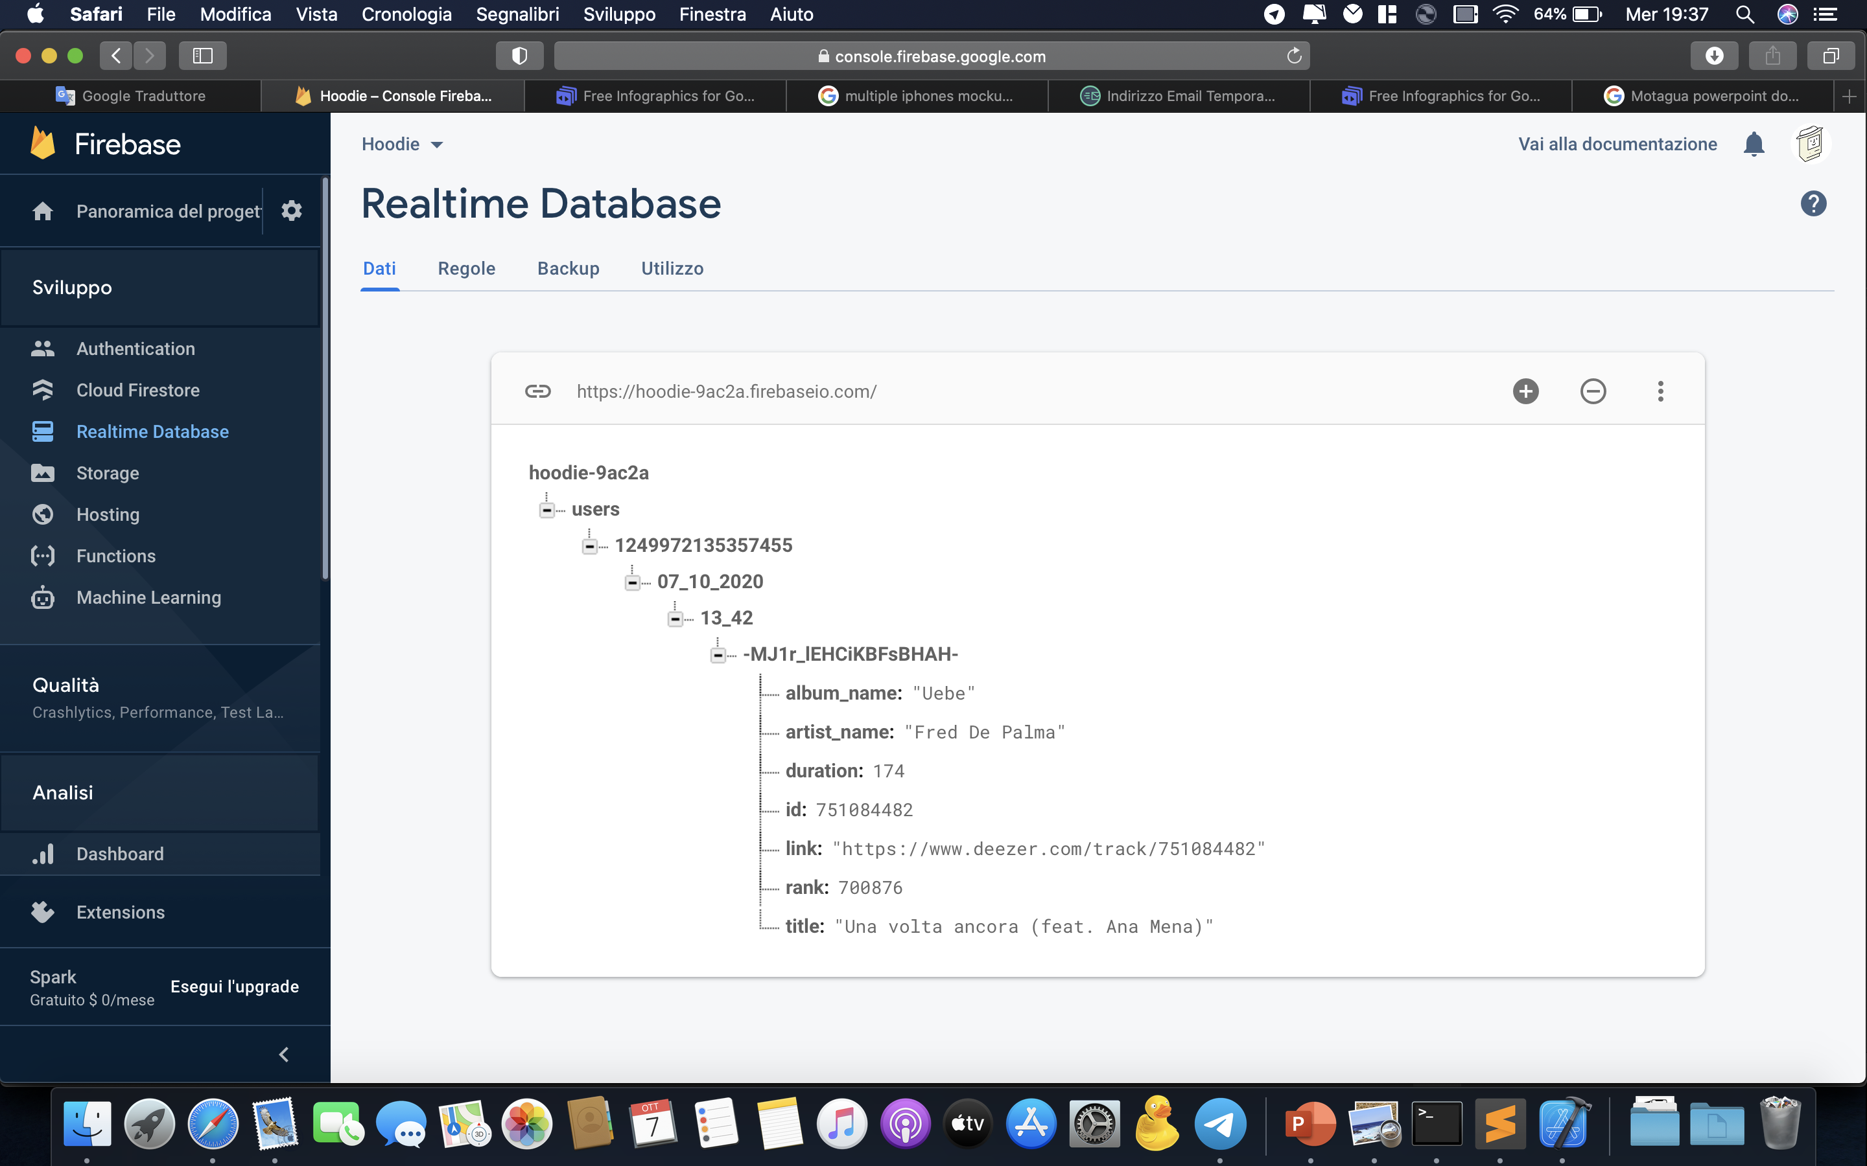
REALTIME DATABASE
The Firebase Realtime Database is a NoSQL cloud-hosted database. Data is stored as JSON and synchronized in real time to every connected client.
All of our clients share one Realtime Database instance and automatically receive updates with the newest data.
Structure.

Slide 13
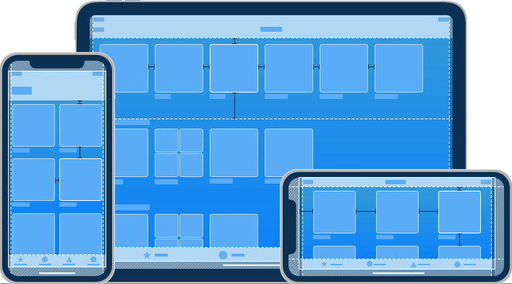



Multi-Platform iOS Design
iOS
Application
Responsive Layout
Multithreading
DispatchQueue + URLSession for https requests on separated thread
(Codable protocol used to convert JSON to native Swift struct)
Model View ViewModel Pattern Design
Design.

Slide 14
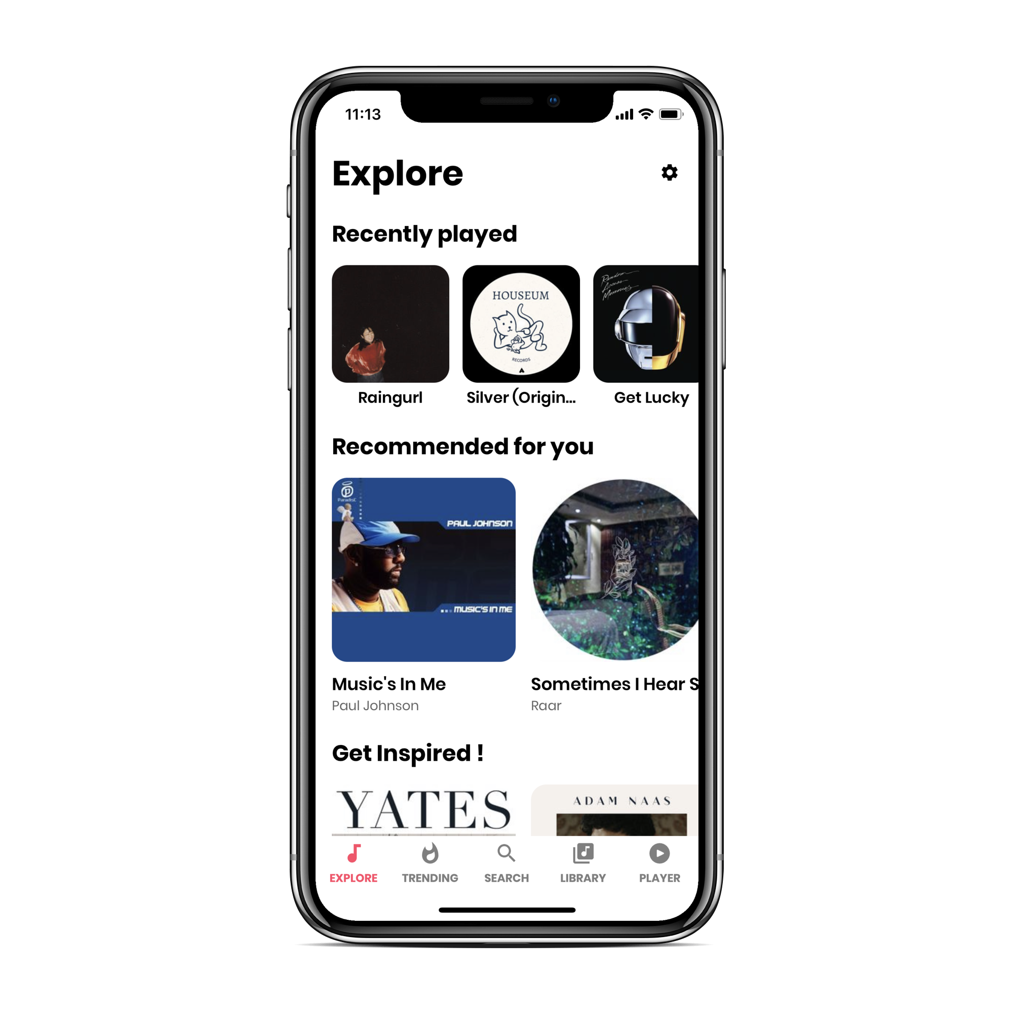
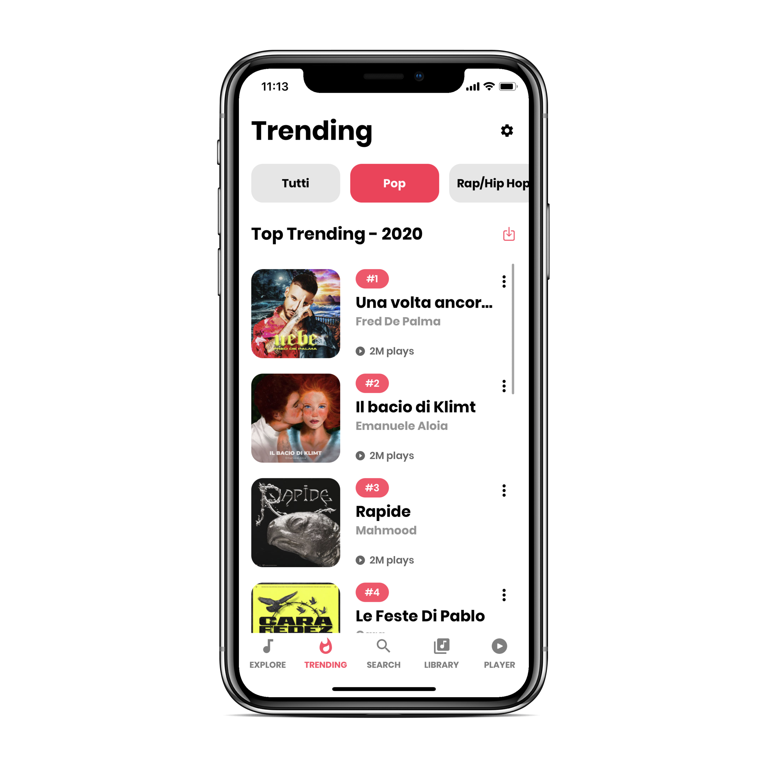
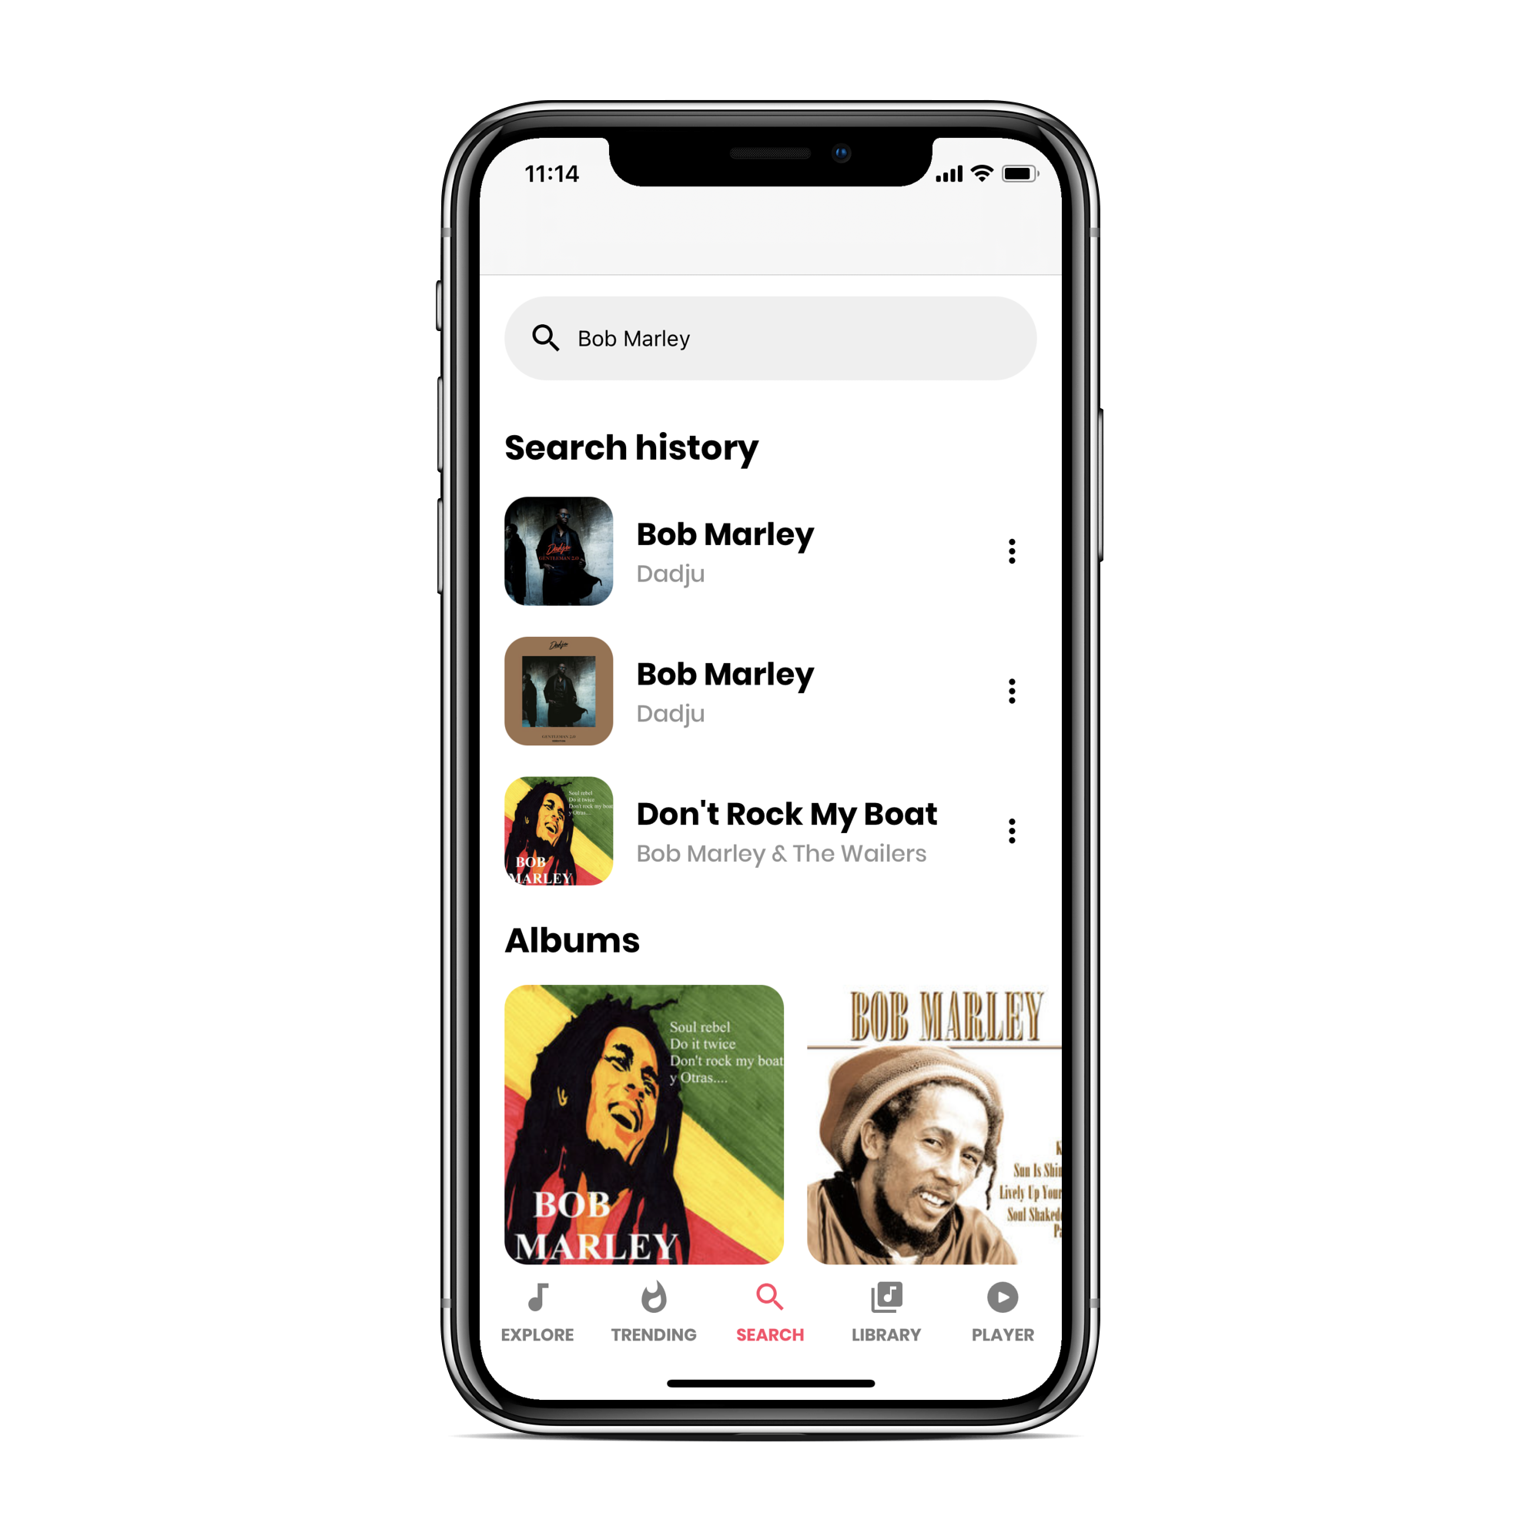
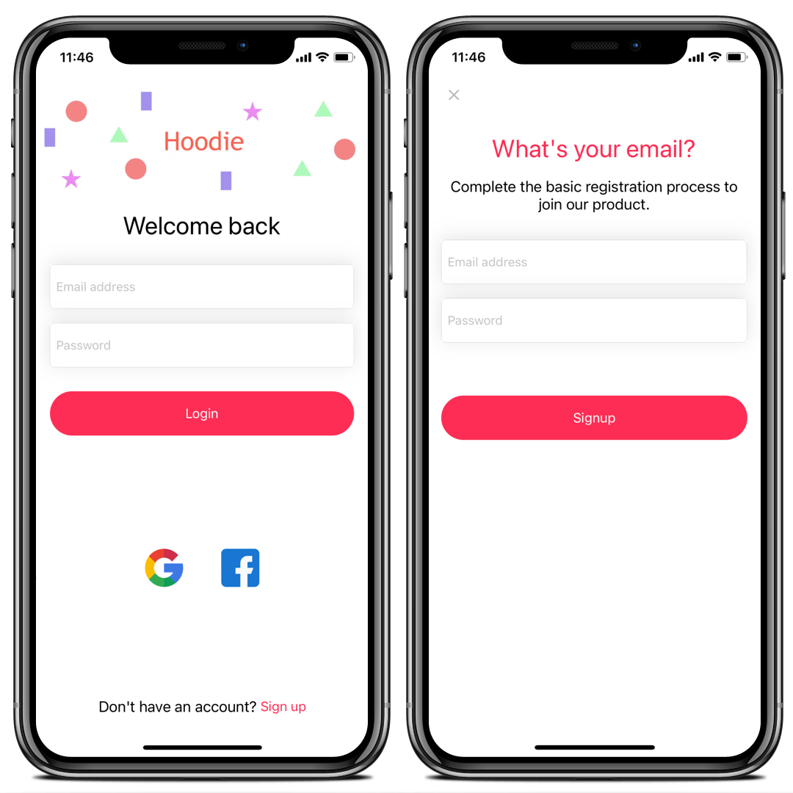
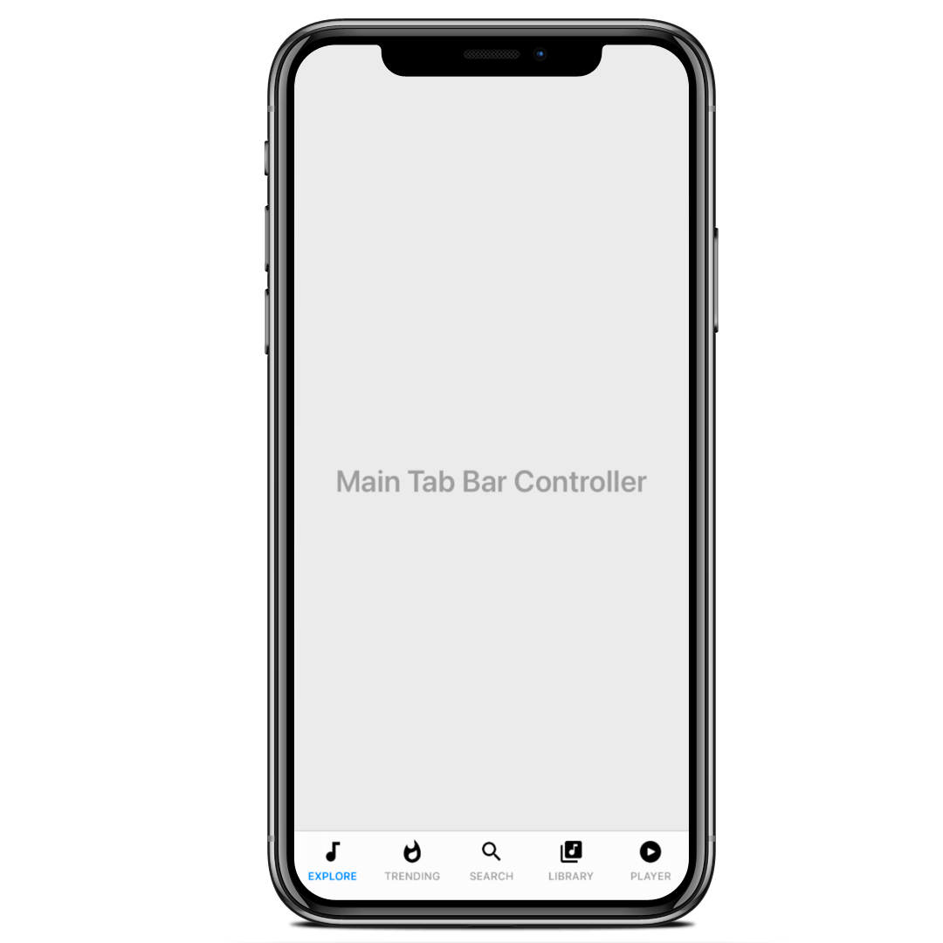
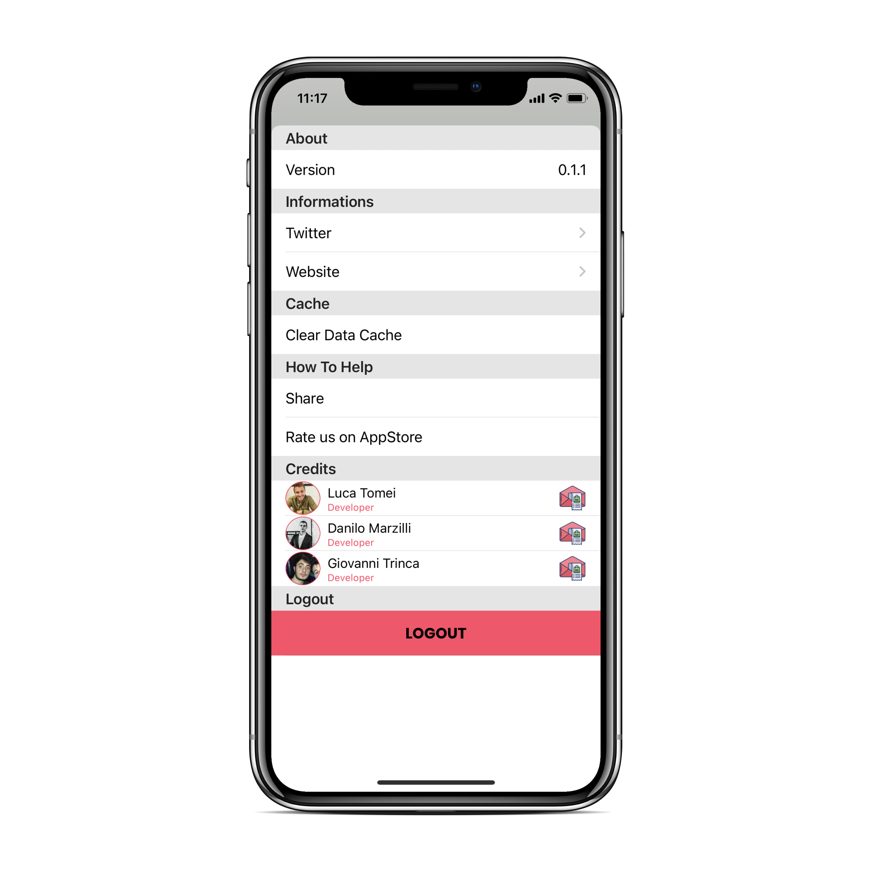
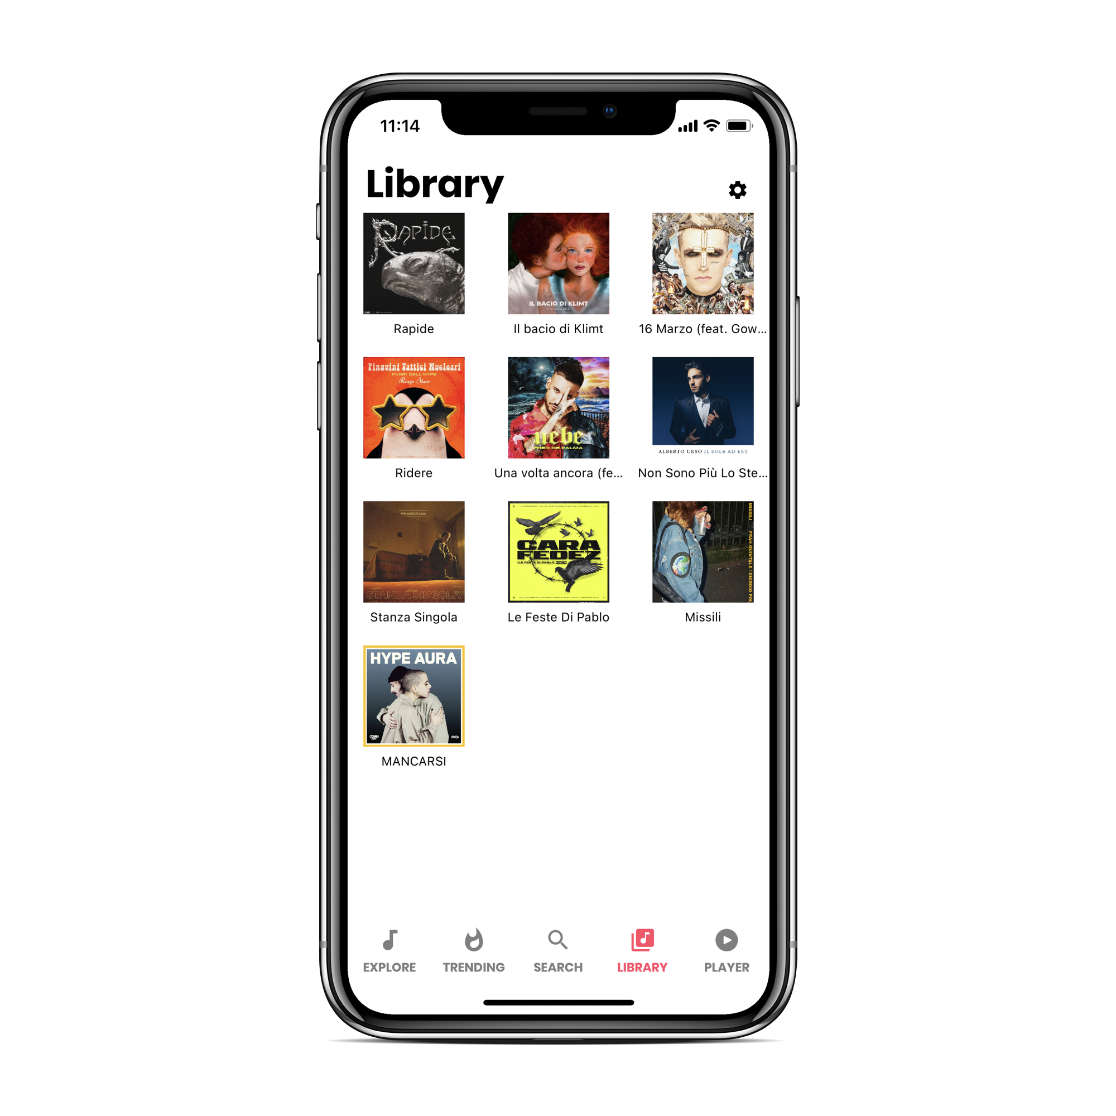
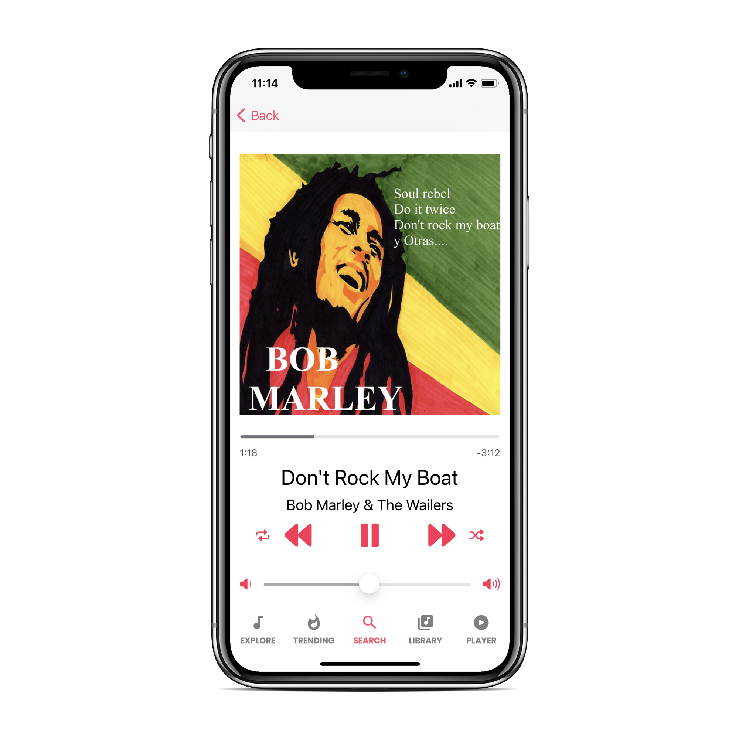
Navigation Path
Design.

Slide 15
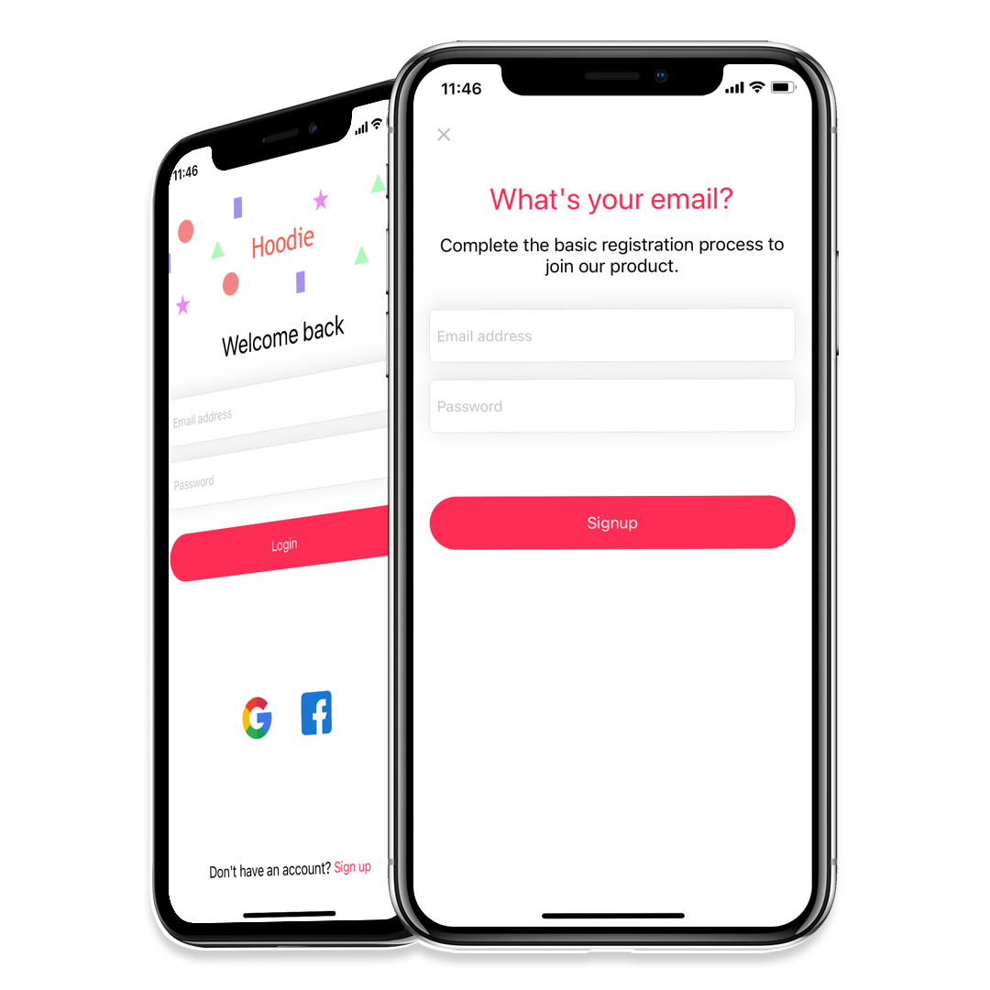
Login & Signup
Login methods supported:
Email and Password (Firebase Auth)
Google OAuth
Facebook
After login or registration, the user is redirected to the main page of the application.
Look and Feel.

Slide 16
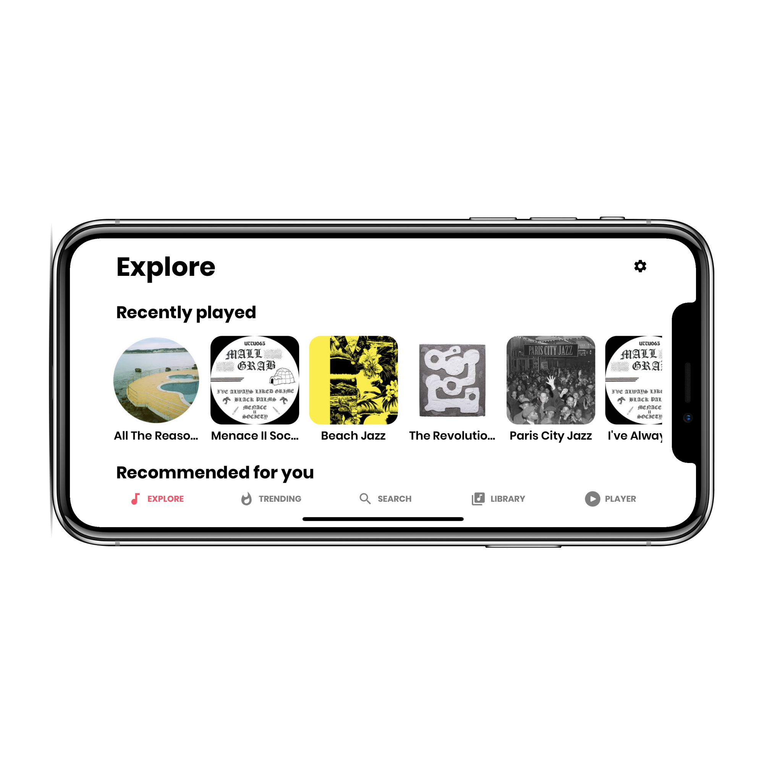
Explore View
Explore:
Recently listened songs
Related songs per genre
Look and Feel.

Slide 17
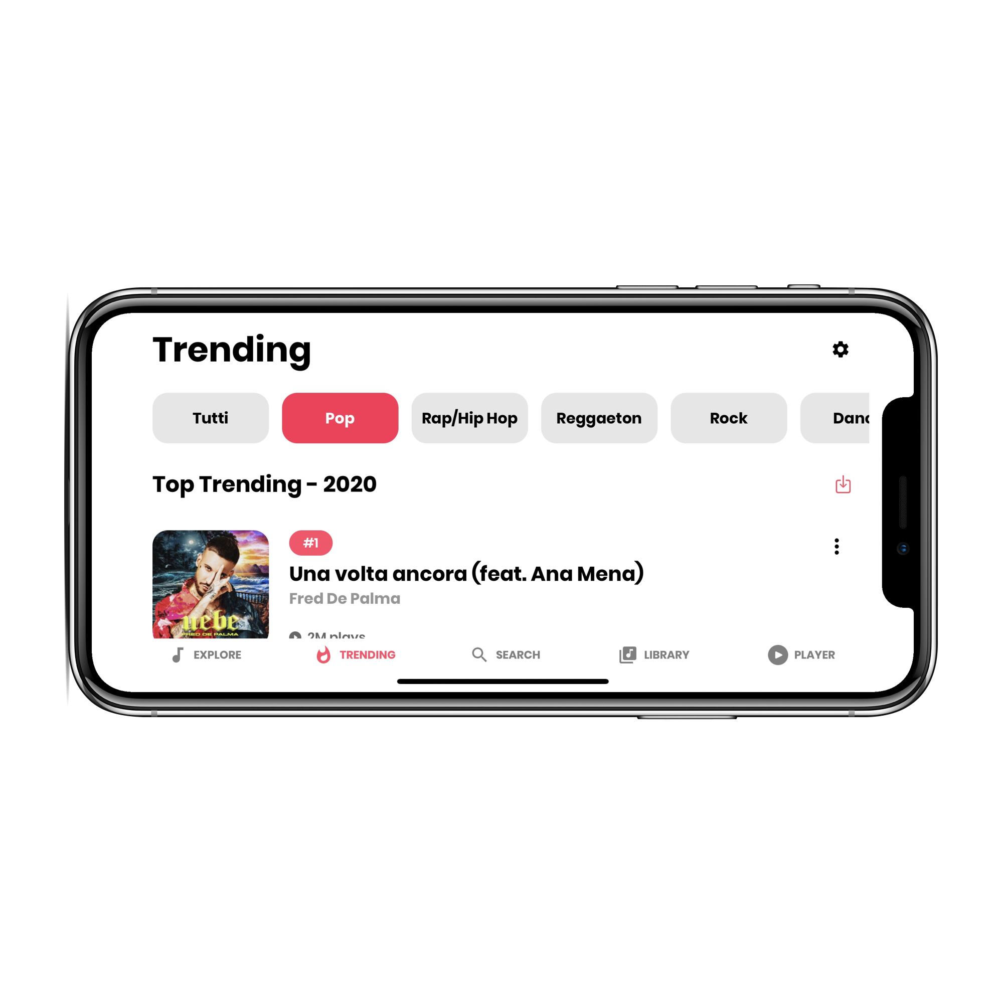
Trending View
Trending obtained by:
Record Sales
Radio Broadcast
Downloads:
Single song
All
Look and Feel.

Slide 18
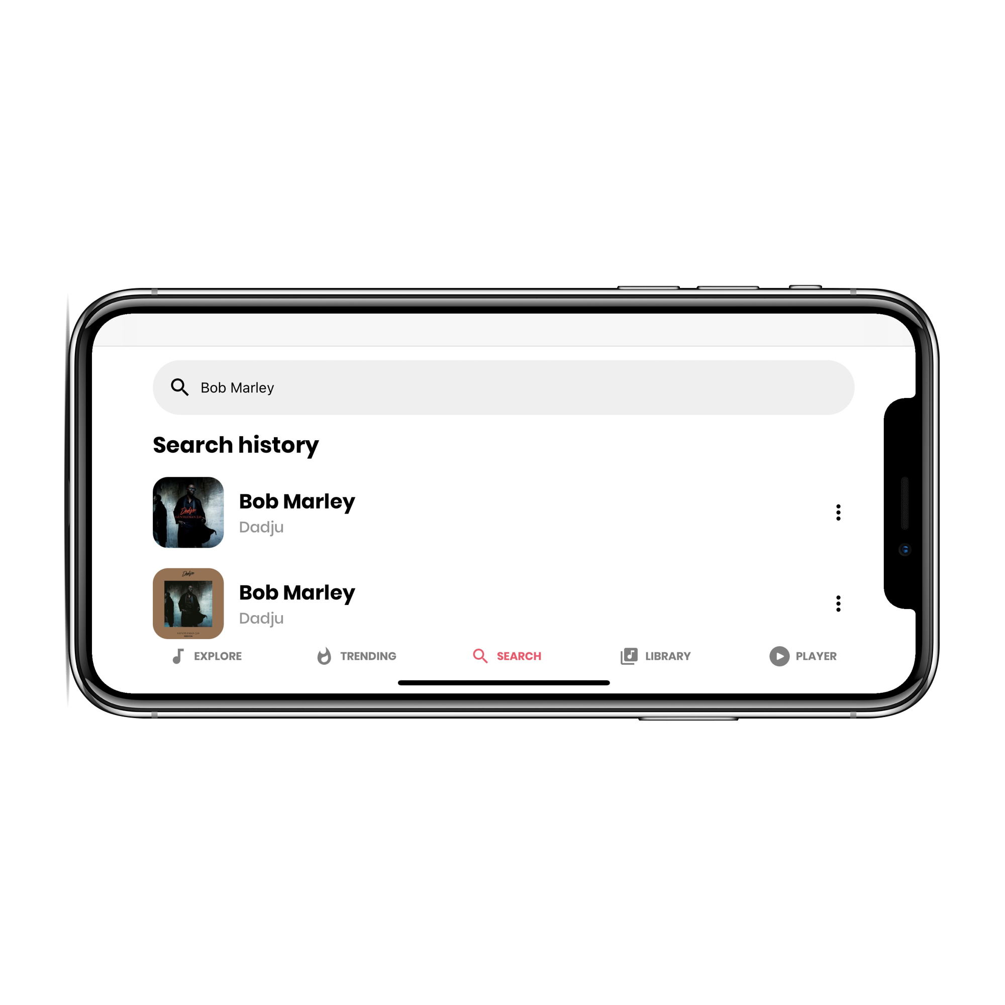
Search View
Search (Deezer API):
Results by Ranking
Play a Song
Download a Song
Look and Feel.

Slide 19
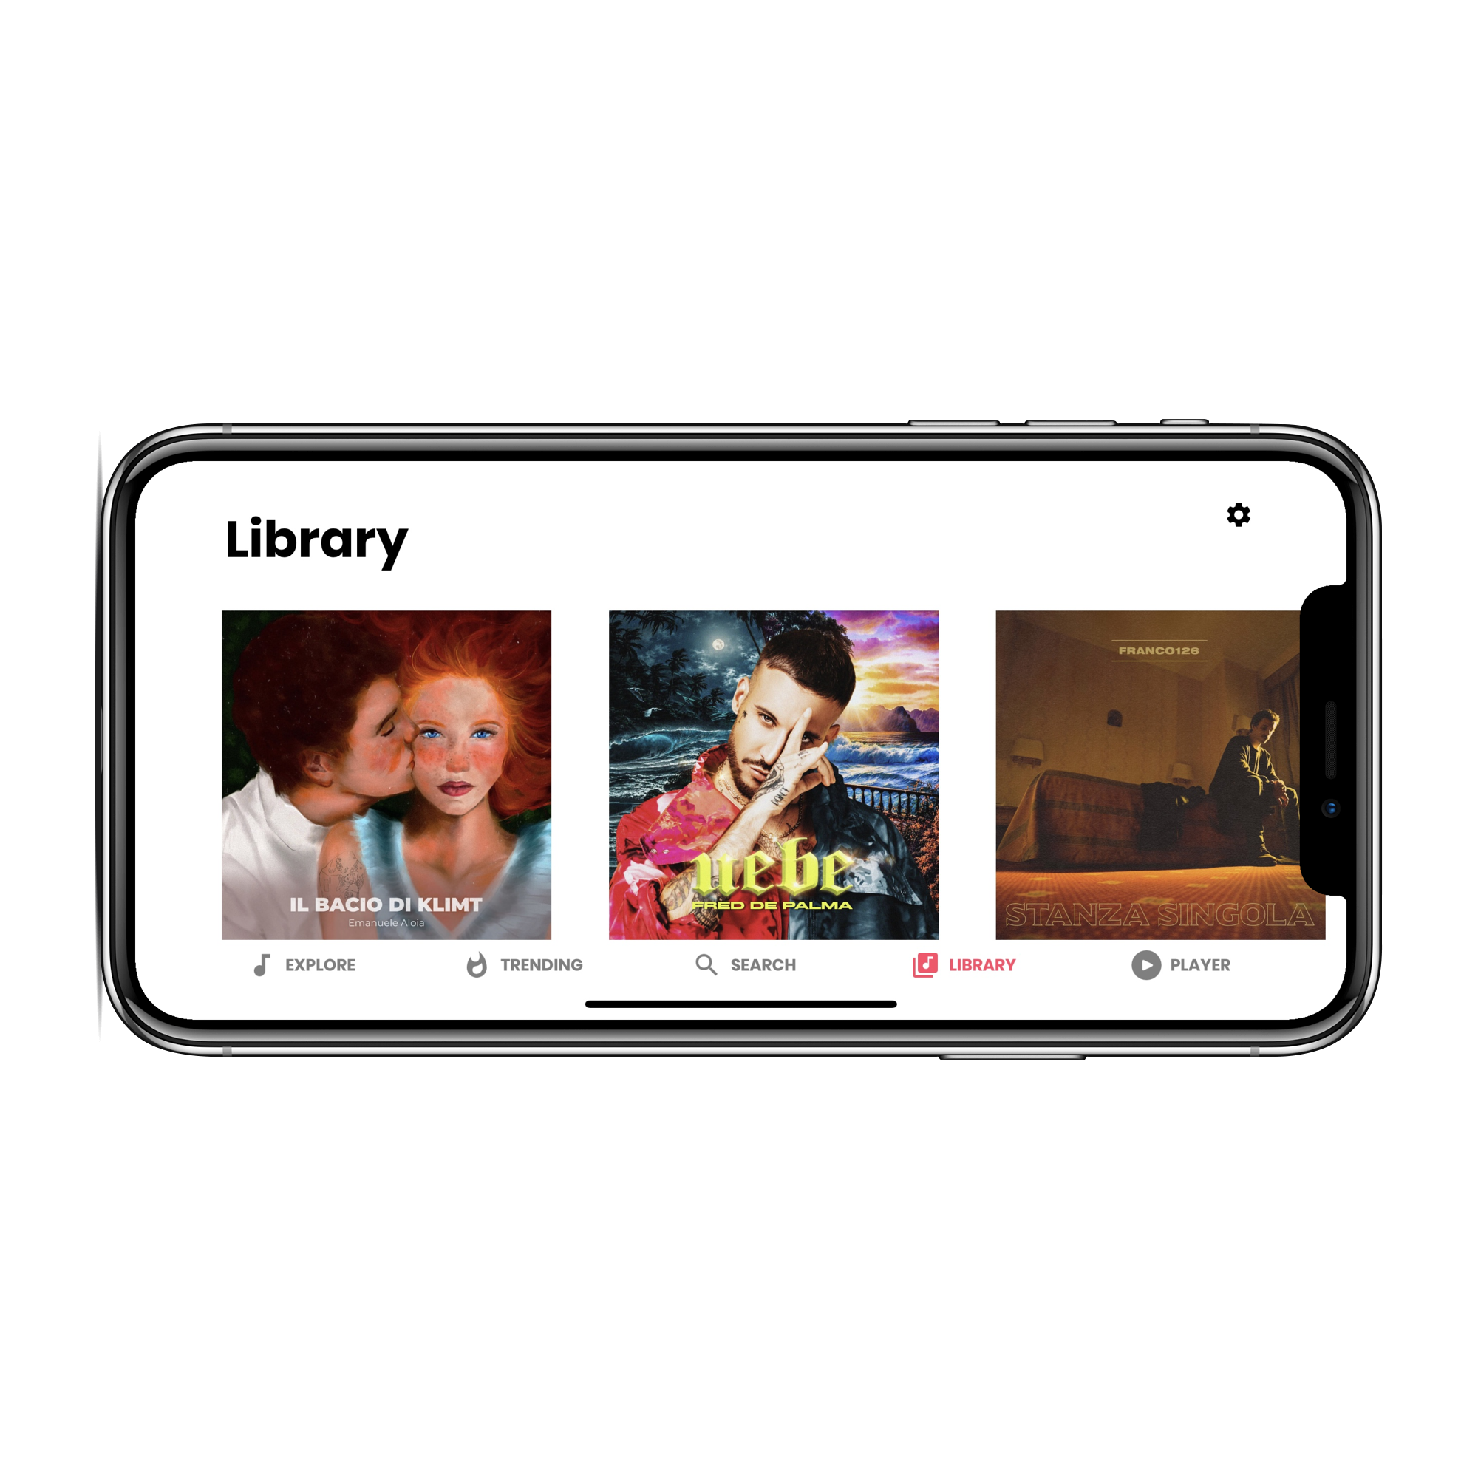
Library View
Library
Shows
Name of the song
Image of the album
User action
Play
Remove
Look and Feel.

Slide 20
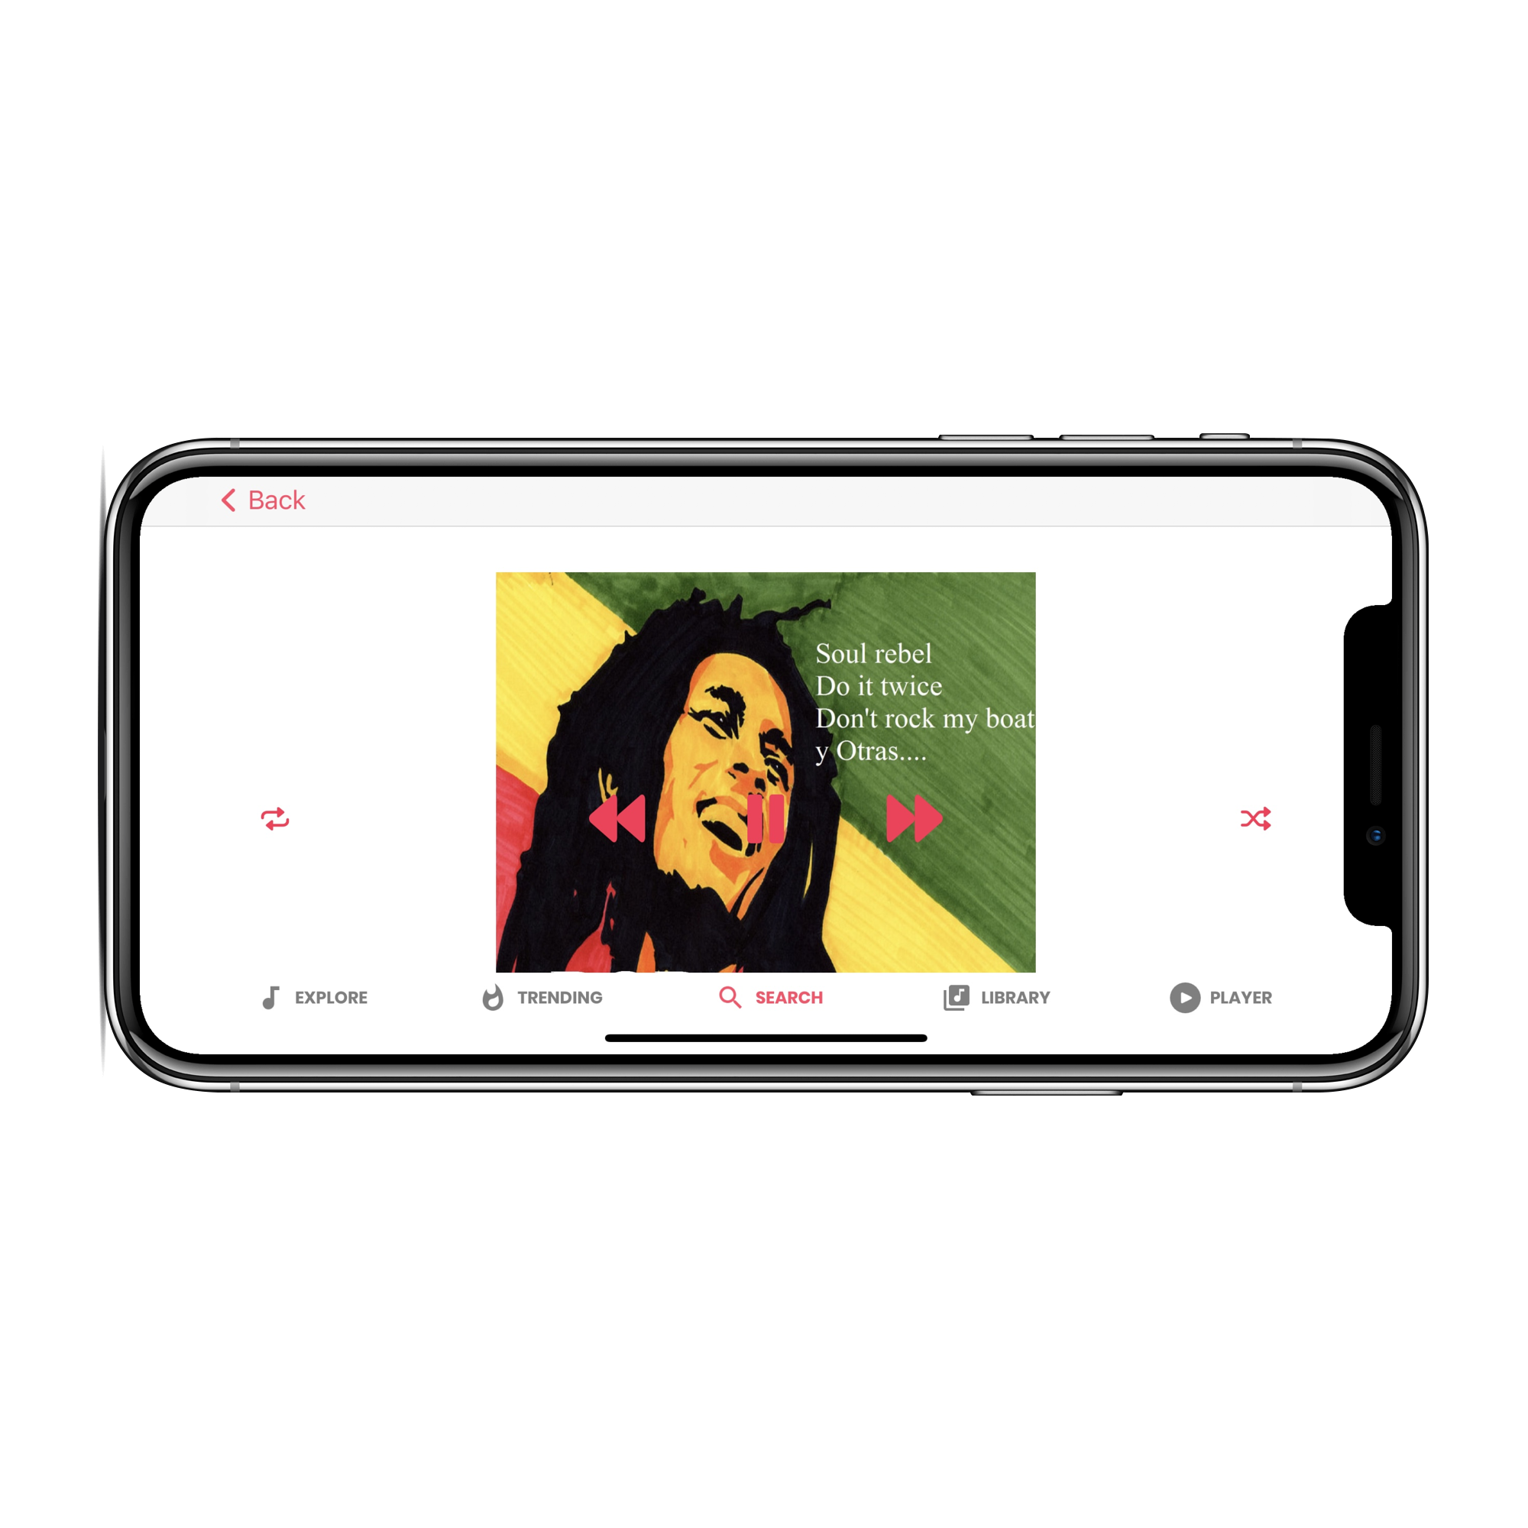
Player View
Our player shows the music currently playing
accompanying the listening showing:
The name of the album, the song, the author
Cover picture
Play/pause, next, previous, shuffle, repeat one, repeat all, volume slider buttons
Look and Feel.

Slide 21
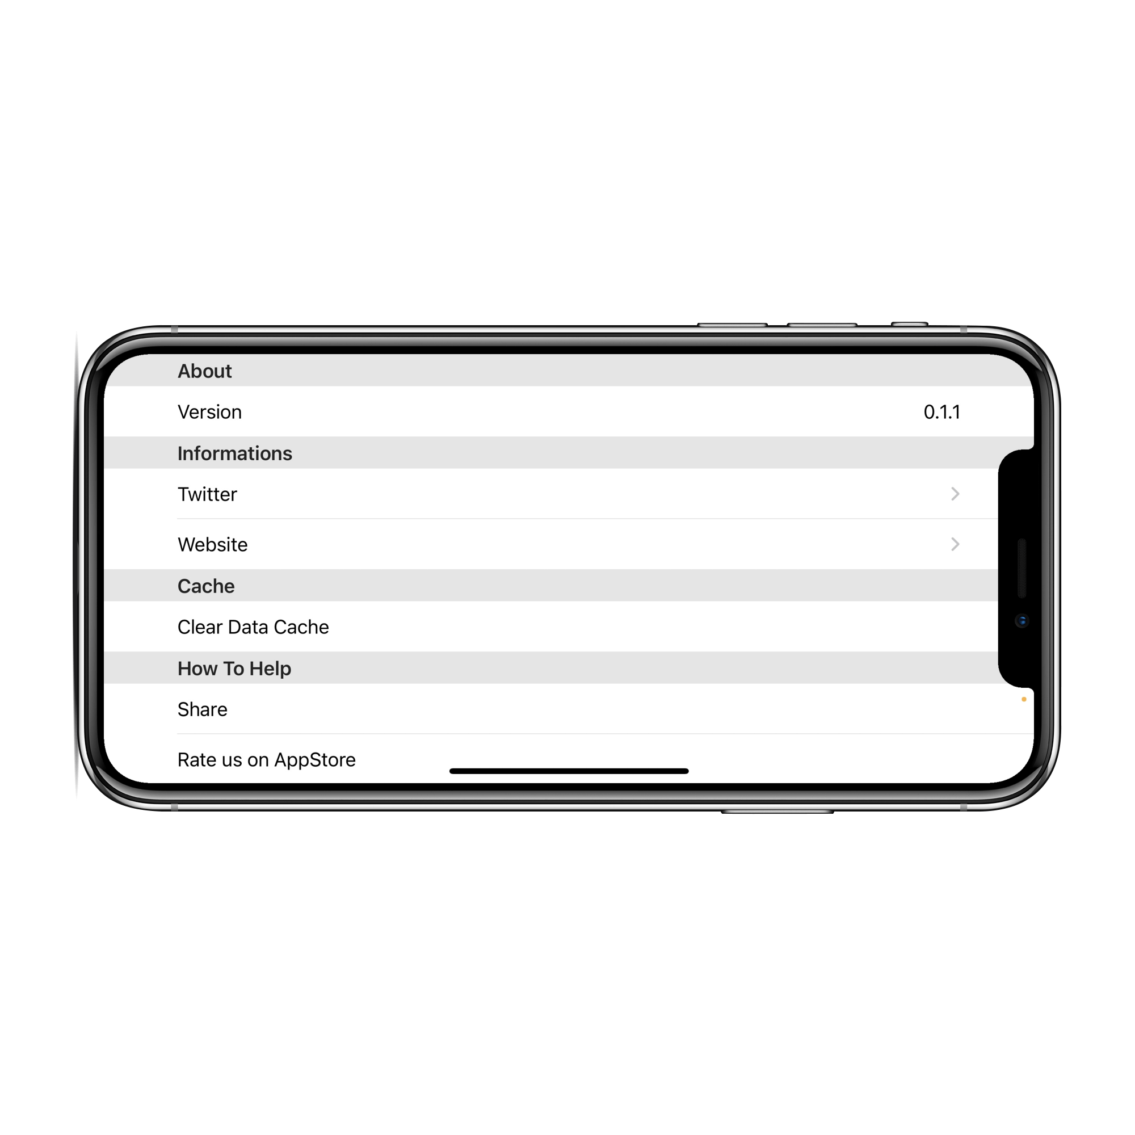
Settings View
Settings:
Verify what version are you using
See app information via Twitter or Website or email
Clear Data Cache
Share our application
Rate us on AppStore
Logout
Look and Feel.

Slide 22

Requirements
What we achieved
Responsive Design.
Auth.
Service.
Multi
Thread.
External
WebAPI.
Storage
Service.
Personal Backend.
Conclusion.

Slide 23

-[
WHAT NEXT?
]-
Future Works.
A possible extension of the application is to support dynamic playlists and self-created suggestions based on the musical preferences of the individual user through the use of the data saved on the Firebase Realtime Database.
Future Work.

Slide 24





-[
For your attention
]-
Thank You

